Slide 1
PROJECT NAME GROUP MEMBERS
MENTAL HEALTH AND SELF IMPROVEMENT
1. Dalvi Kumar Subhash
2. Kapse Sameer Bhimraj
3. Kapse Yashvardhan Sandeep

Slide 2
INTRODUCTION
Mental illness is becoming a serious global health problem worldwide, with a growing number of patients suffering from depression, anxiety and other disorders. New solutions are needed to tackle this issue. The main goal of this research project is to develop prediction models to classify users with poor mental health from social network data and then implement an intervention model to help these users.

Slide 3
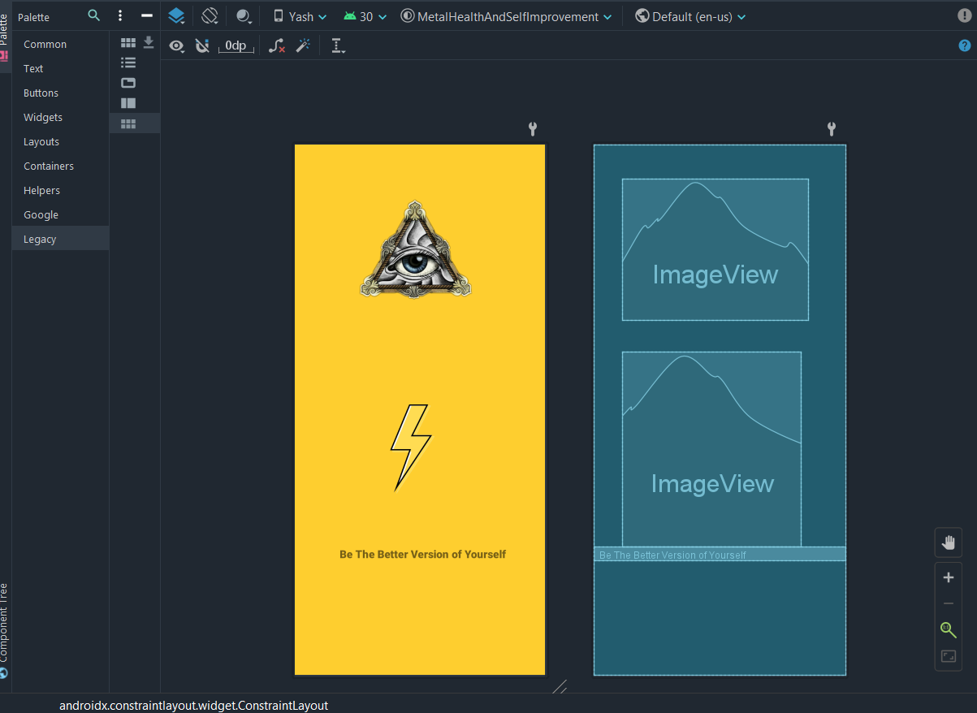
START SCREEN

Slide 4
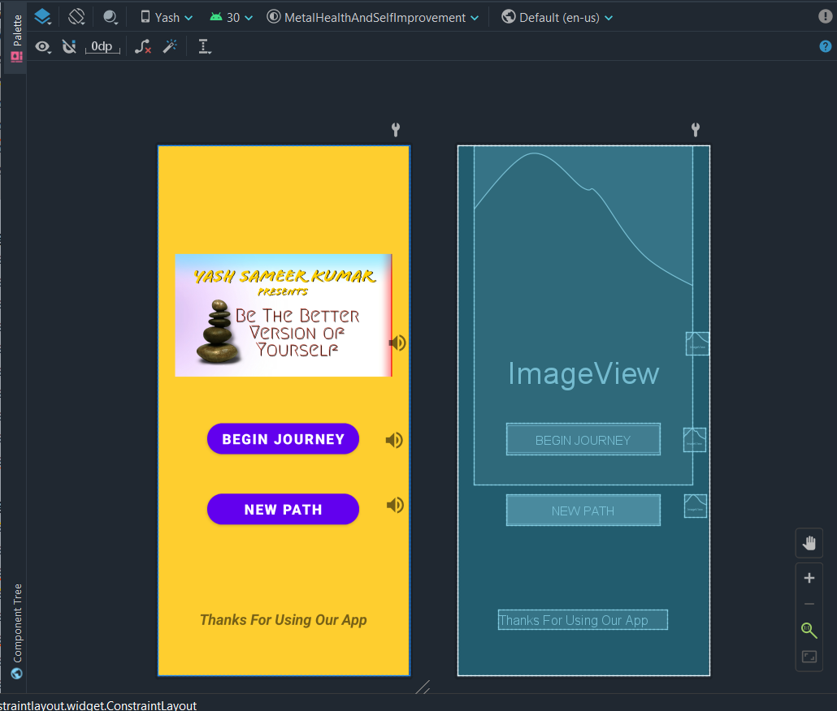
HOME SCREEN / DASHBOARD

Slide 5
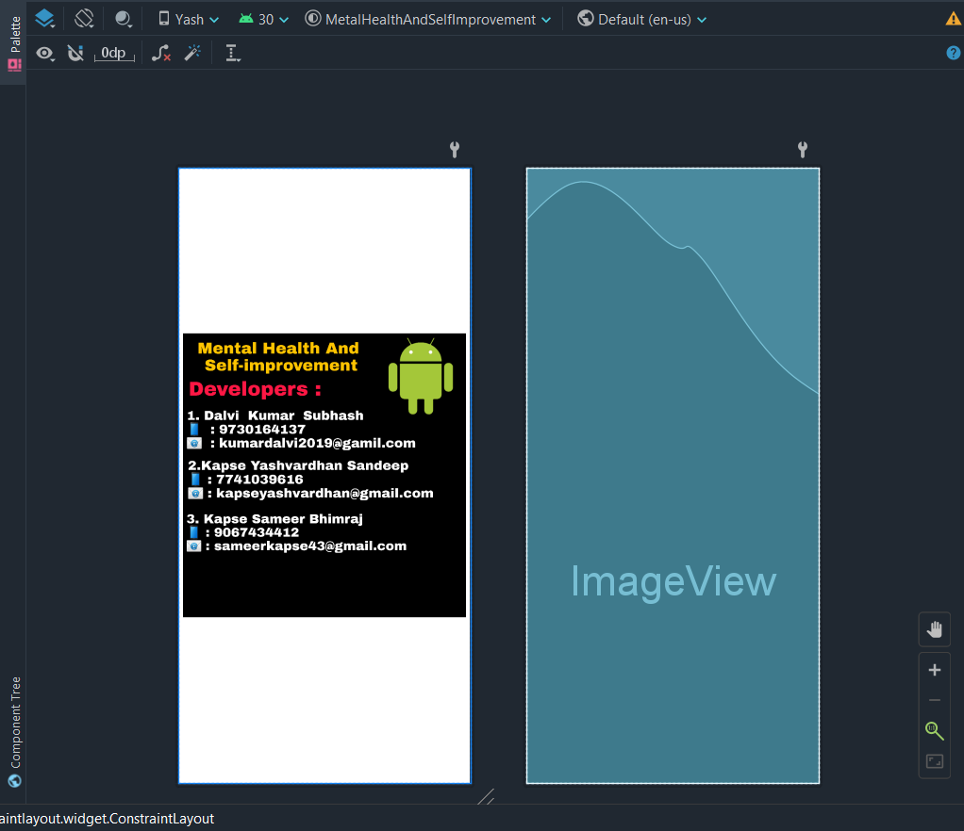
ABOUT US

Slide 6
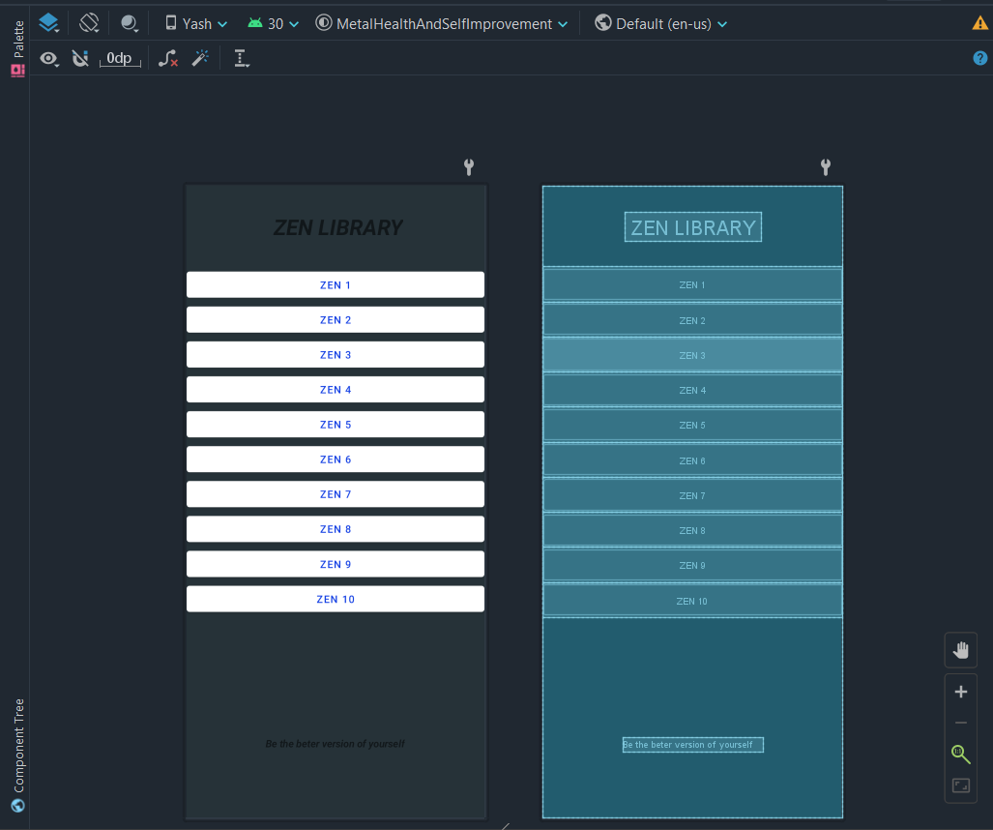
ZEN MUSIC SCREEN

Slide 7
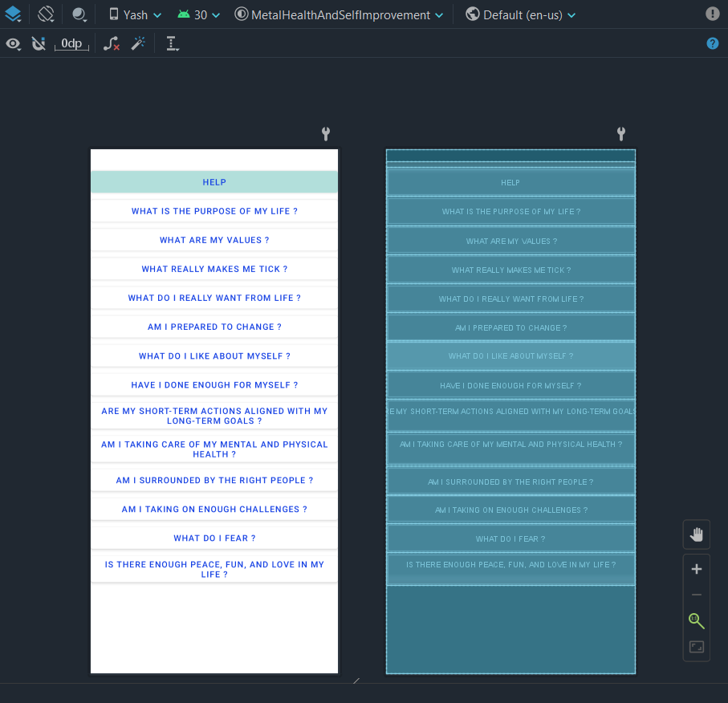
QUESTION SET SCREEN

Slide 8
FUTURE SCOPE
Our project technologies can be extended in to following future scope:
In the world of today, Mental health app is must and this is just an small initiative and there is a lot more than this.
Music has a lot potential in todays world and has a big future in store.
Infact, the Android Architecture by Google is a lot helpful in defining the best practices. It makes Android App development much easier and understandable to handle.
There’s a drastic rise in the number of Android Applications today. Infact, real-time applications are more in trend that helps in making payment, or shopping online

Slide 9
CONCLUSION
This thesis has shown what Android is and how it works with XML in combination with Java. It has described how to setup a development environment and the emulator AVD.
We were successful in making an app, which can understand our question and give us a defining answer to overcome that question and connecting all the strings and making an Music section for people who needs an calmness into their life. It was a great journey from the start to now.
So henceforth, we have finally joined all the dots to make this possible.

